Slide 1
Object Oriented Programming
Week 5
Abeer GAUHER
Email: abeer.gauher@nu.edu.pk
Office: CS BASEMENT 2, Office number 17

Slide 2
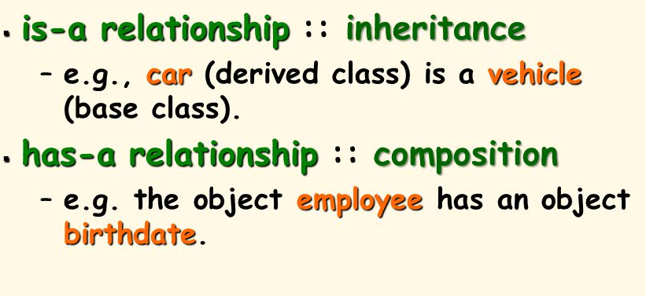
Object Relationship
is-a relationship
has-a relationship

Slide 3
has-a Relationship
In a has-a relationship, an object contains one or more objects of other classes as members.
A car has a steering. An office has a department.

Slide 4
has-a Relationship
class Office
{
Department d;
// any other members
};

Slide 5
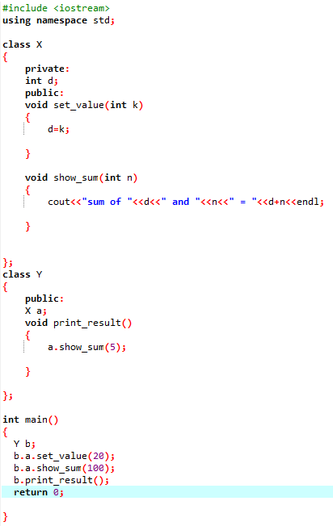

has-a Relationship Example
Class X has one data member ‘d’ and two member functions ‘set_value()’ and ‘show_sum()’.
set_value() function is used to assign value to ‘d’.
show_sum() function uses an integer type parameter.
Class Y has an object of class x that is Composition. This class has its own member function print_result().
In the main() function, an object ‘b’ of class y is created. The member function set_value() of object ‘a’ that is the sub-object of object ‘b’ is called by using two dot operators. One dot operator is used to access the member of the object ‘b’ that is object ‘a’, and second is used to access the member function set_value() of sub-object ‘a’ and ‘d’ is assigned a value 20.

Slide 6
has-a Relationship Example
In the same way, the show_sum() member function is called by using two dot operators.
The value 100 is also passed as a parameter.
The member function print_result of object ‘b’ of class Y is also called for execution.
In the body of this function, the show_sum() function of object ‘a’ of class X is called for execution by passing value 5.

Slide 7
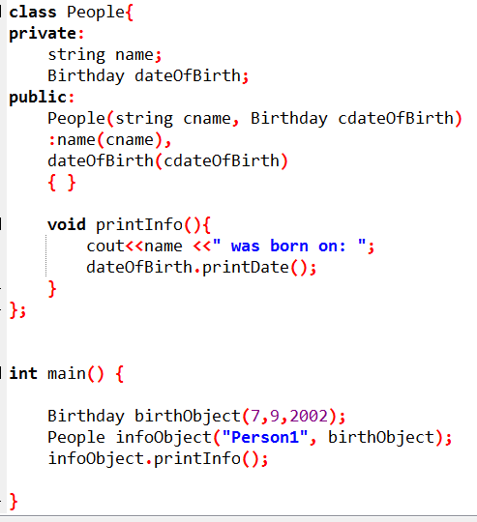
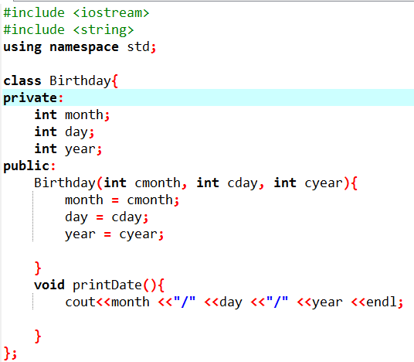
has-a Relationship Example

